Slide 1
PIPELINING
Pipelining is a technique of decomposing a sequential process into sub-operations, with each sub-process being executed in a segment that operates concurrently with all other segment.

Slide 2
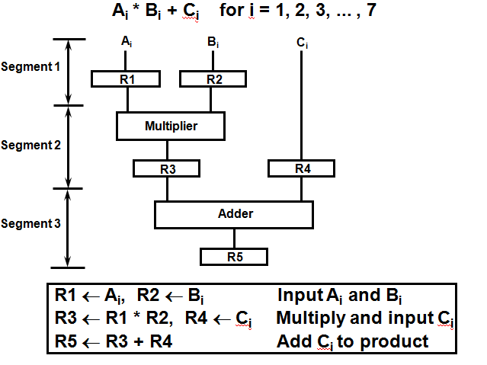
Example for Pipeline Processing

Slide 3
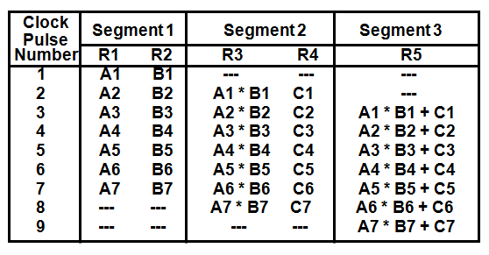
Operations in each pipeline stage

Slide 4
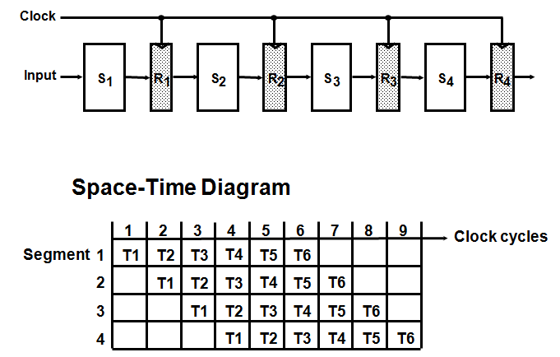
General Four-Segment Pipeline

Slide 5
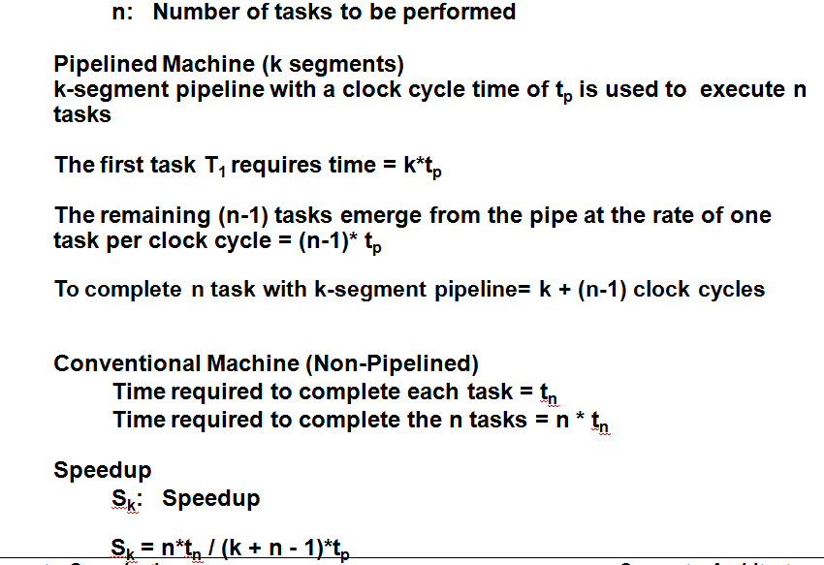
Pipeline Speedup

Slide 6
Q1. In certain scientific computation it is necessary to perform the arithmetic operation (Ai+Bi)*(Ci*Di)
Specify the pipeline configuration to carry out this task.
List the content of all registers of all the registers in the pipeline for i=1 to 6.
Q2. Draw a space time diagram for a six-segment pipeline showing the time it takes to process eight tasks.
Q3. A non-pipelined system takes 50ns to process a task. The same task can be processed in a six-segment pipeline with a clock cycle of 10ns. Determine the speedup ratio of the pipeline for 100 tasks.

